Slide 1



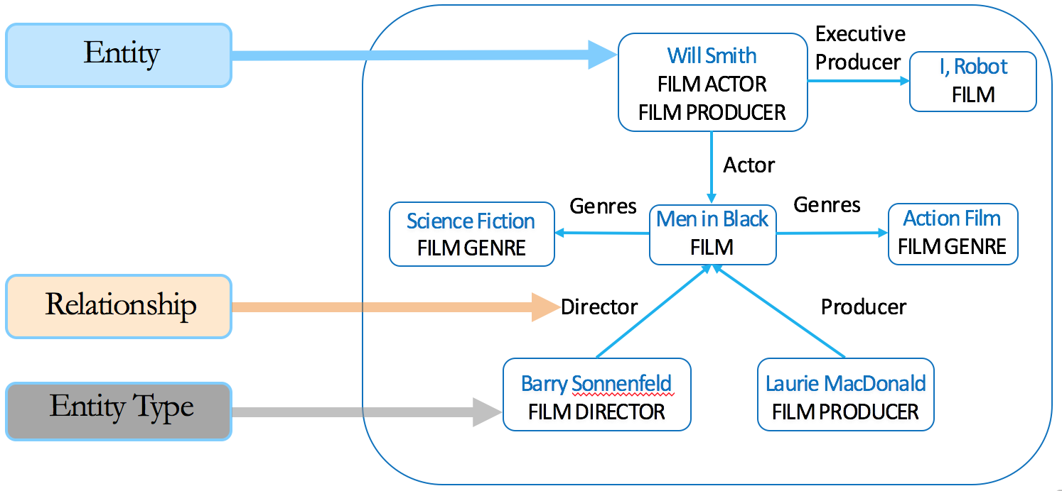
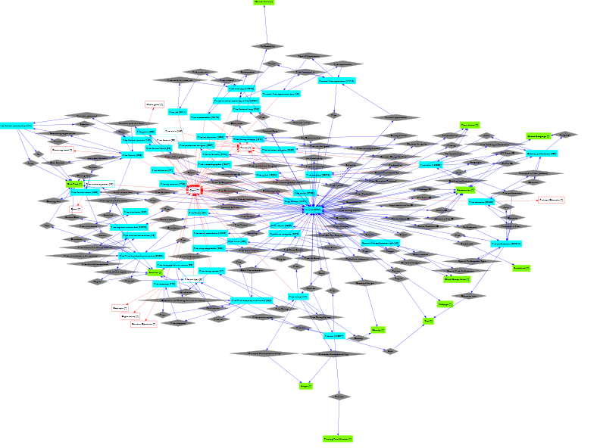
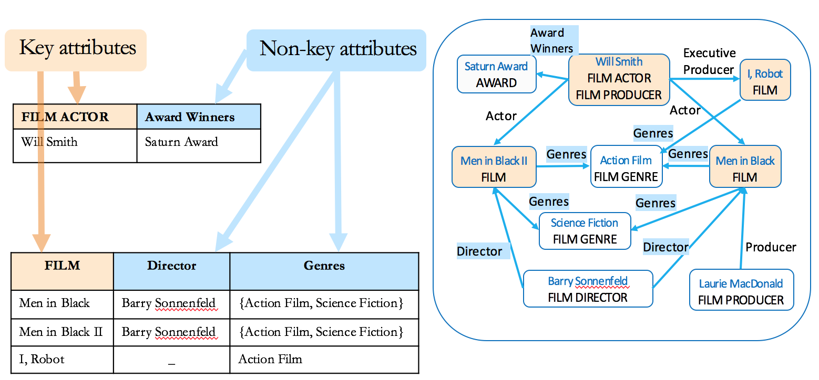
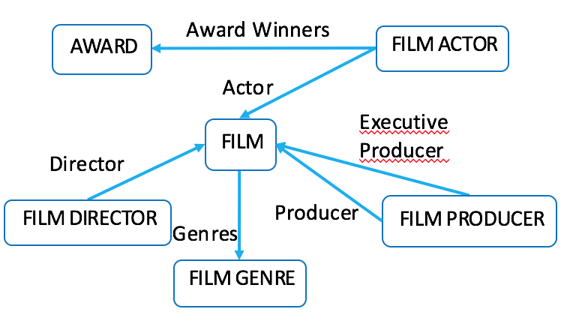
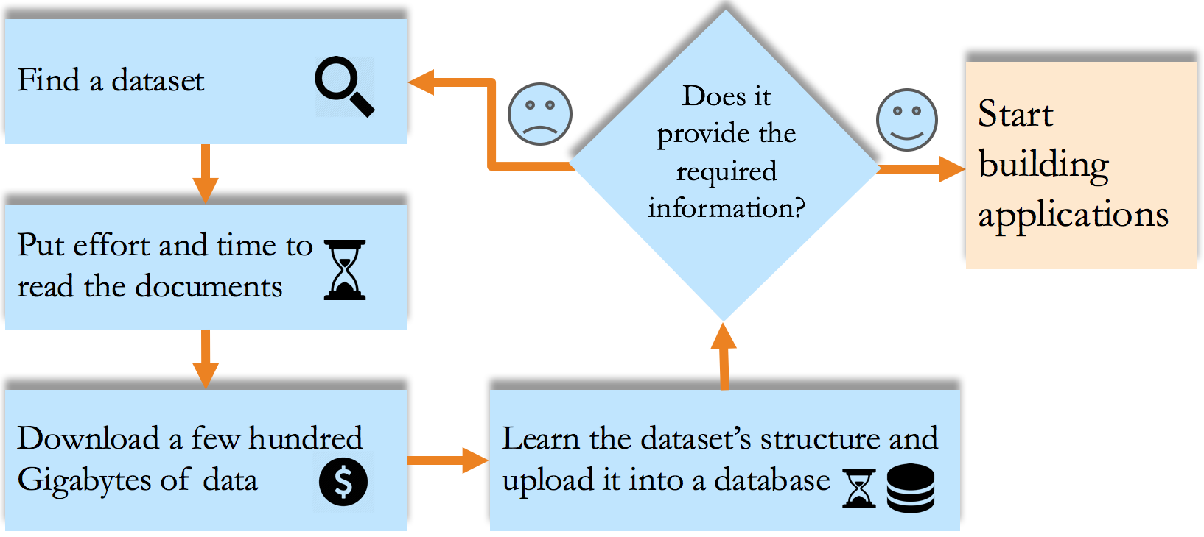
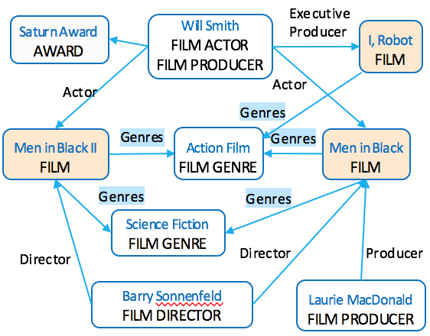
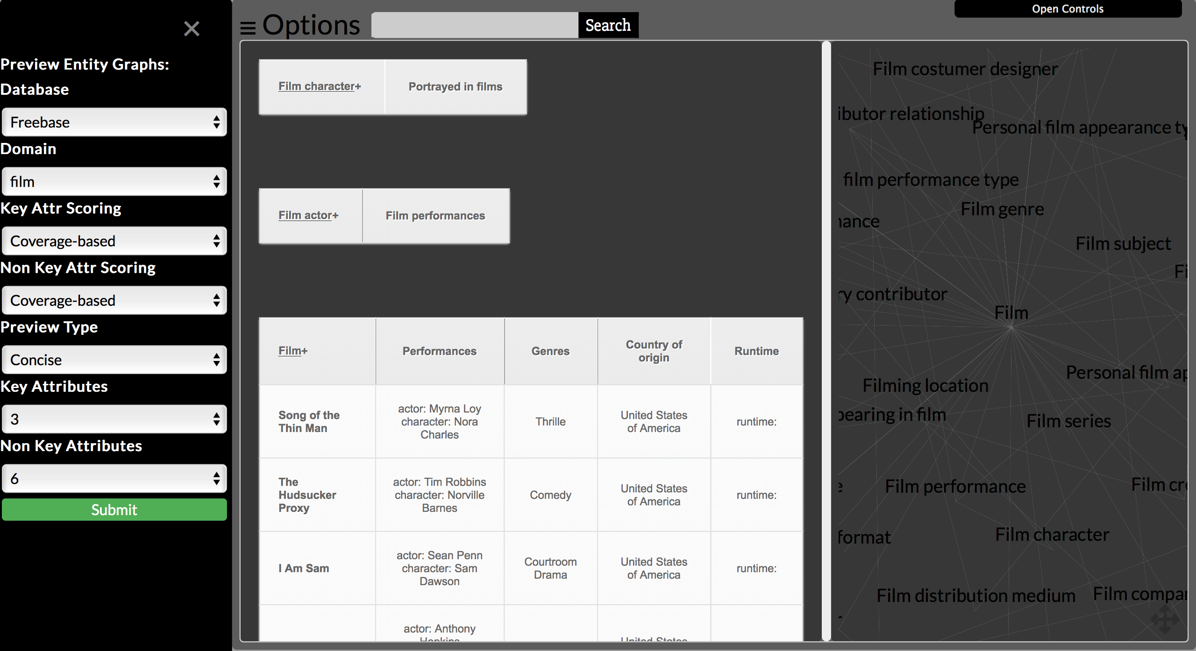
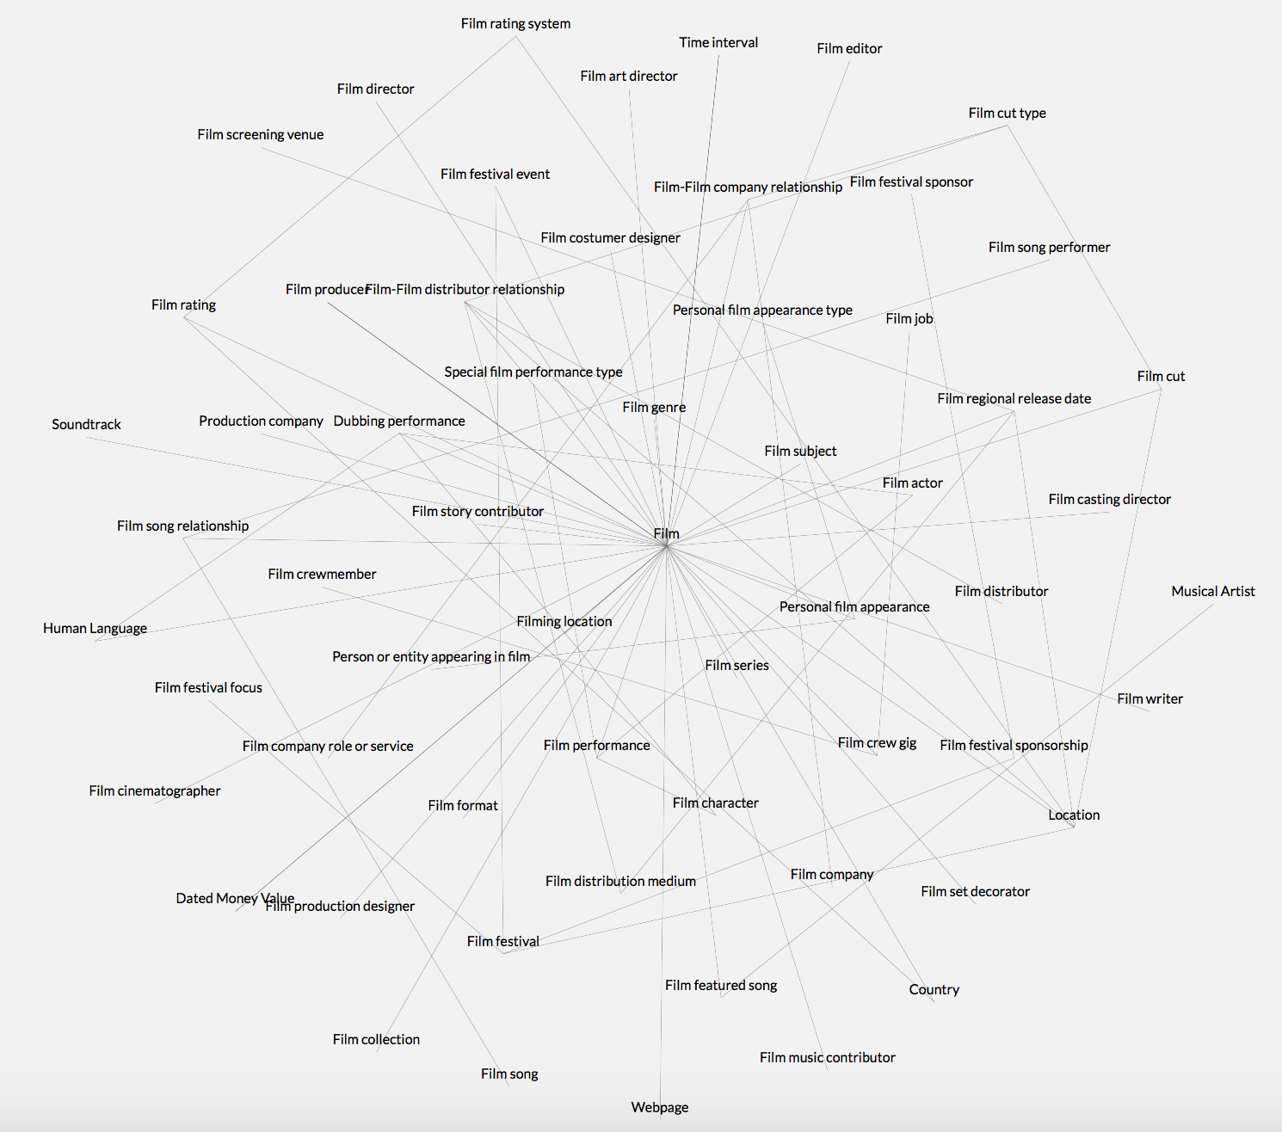
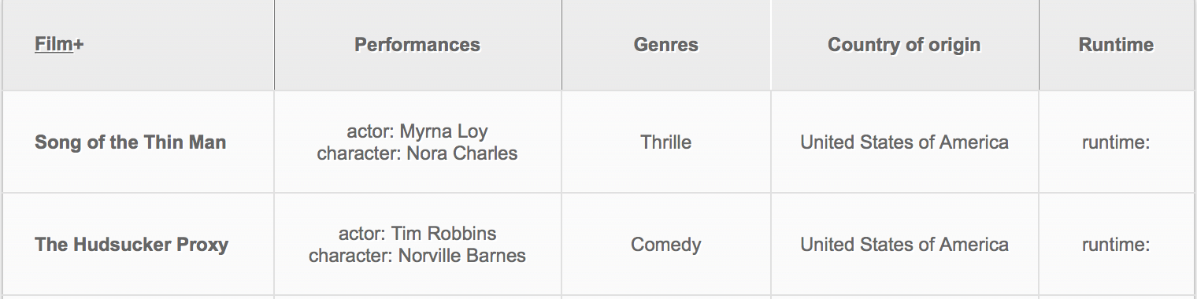


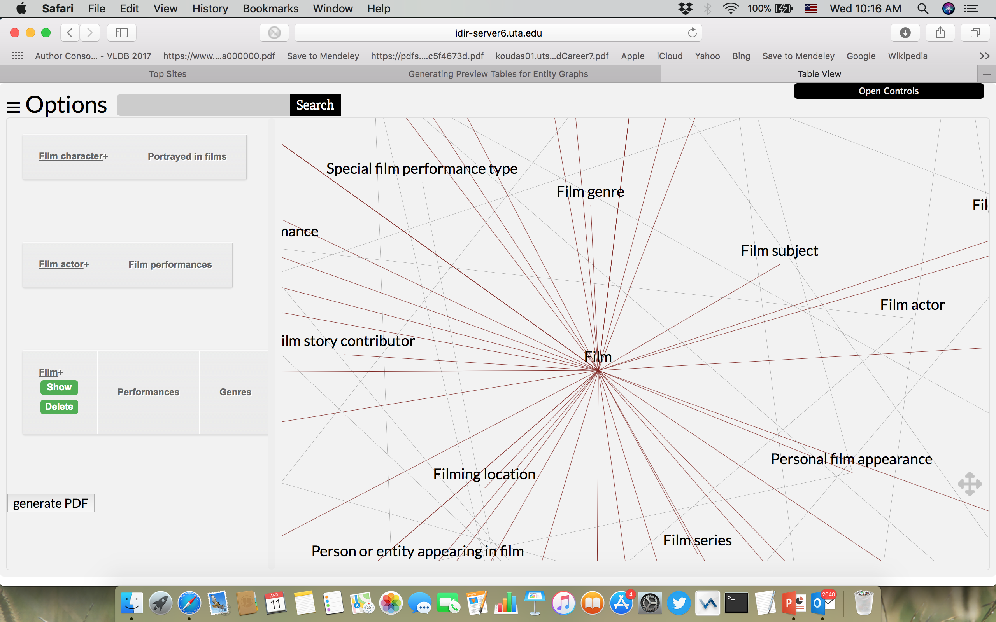
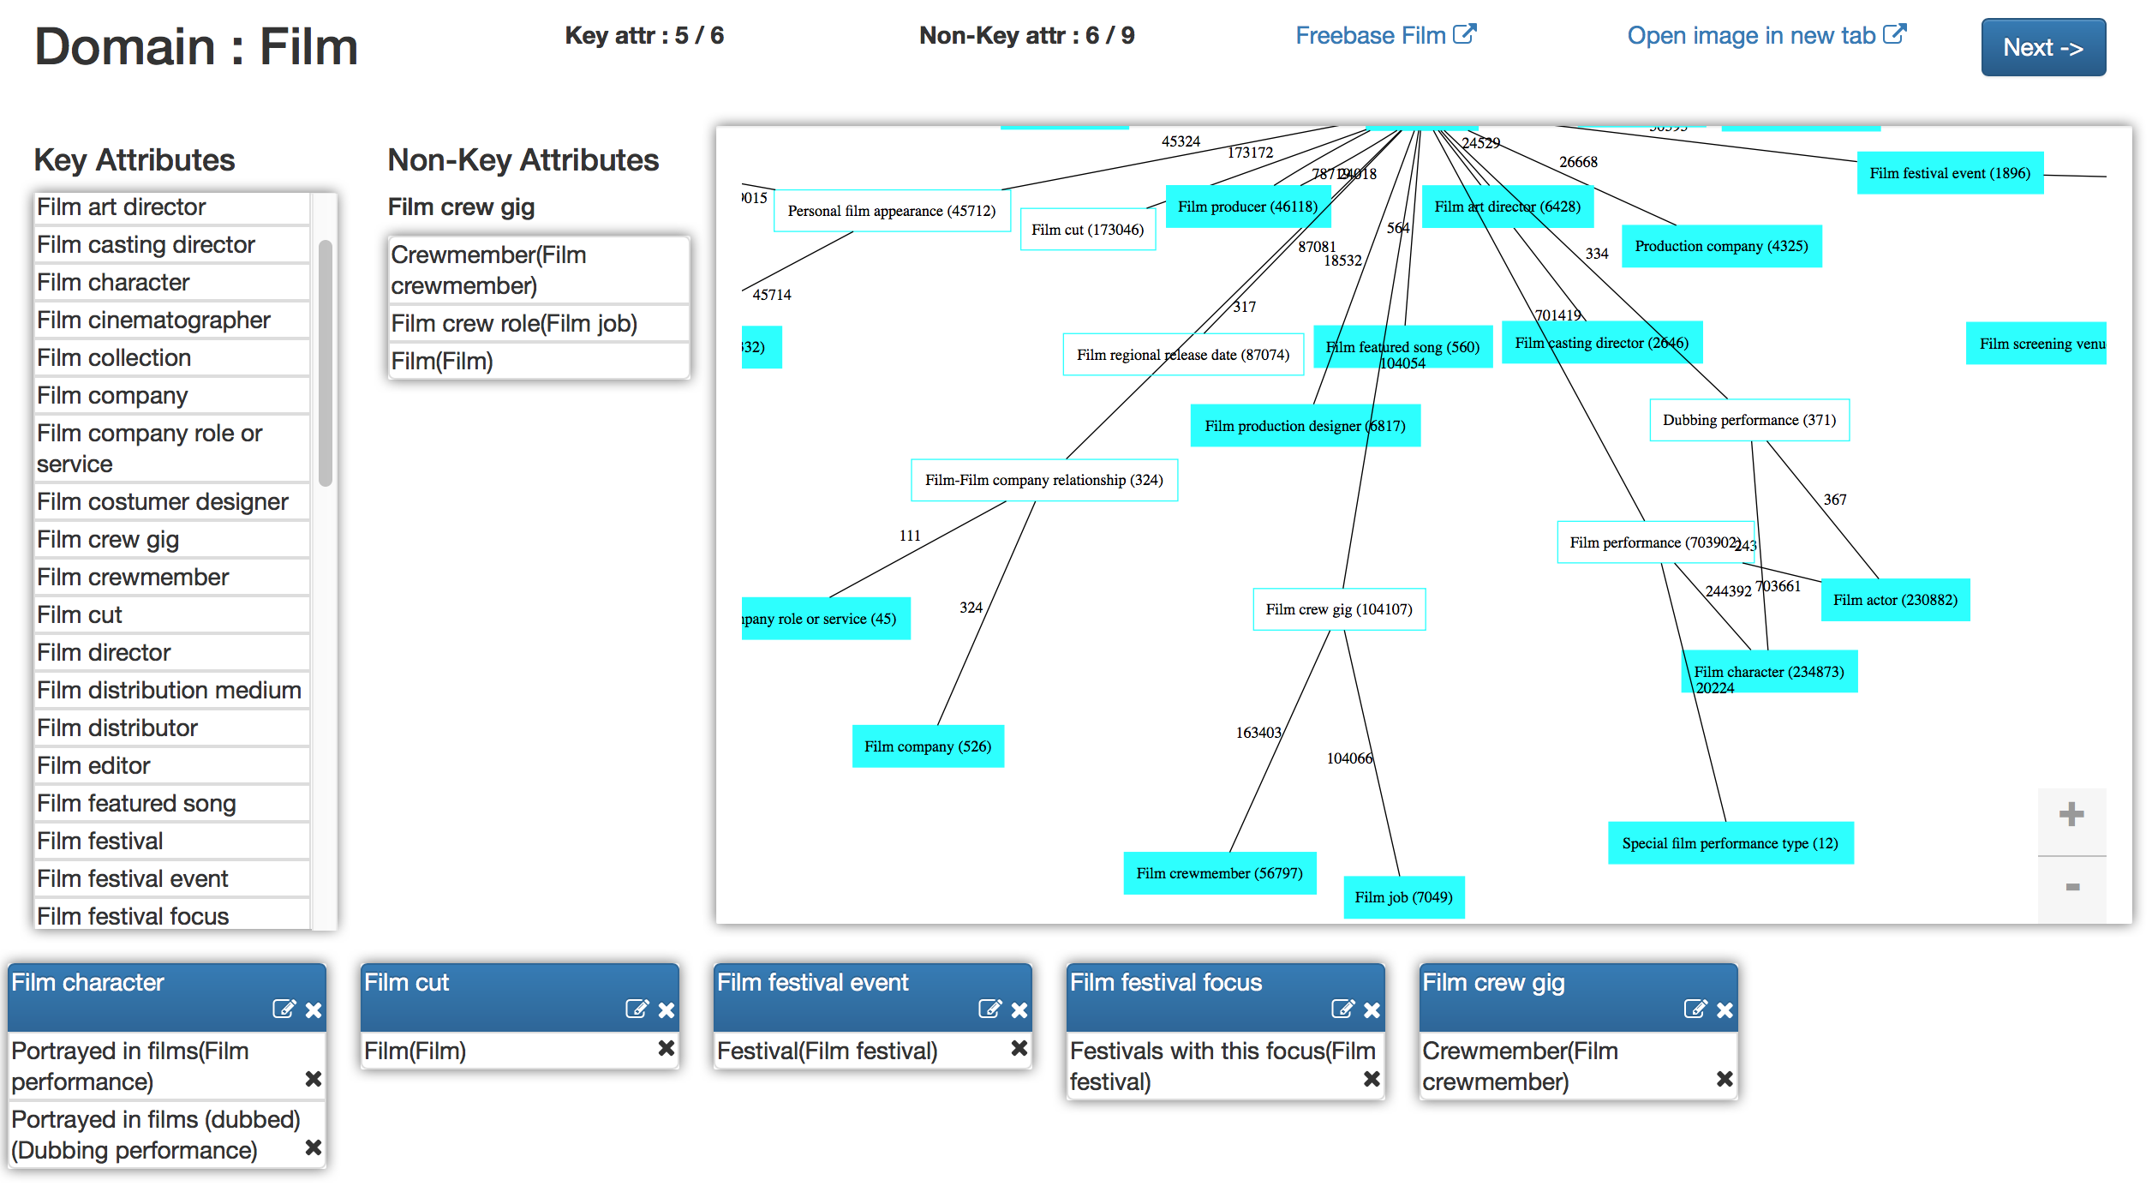
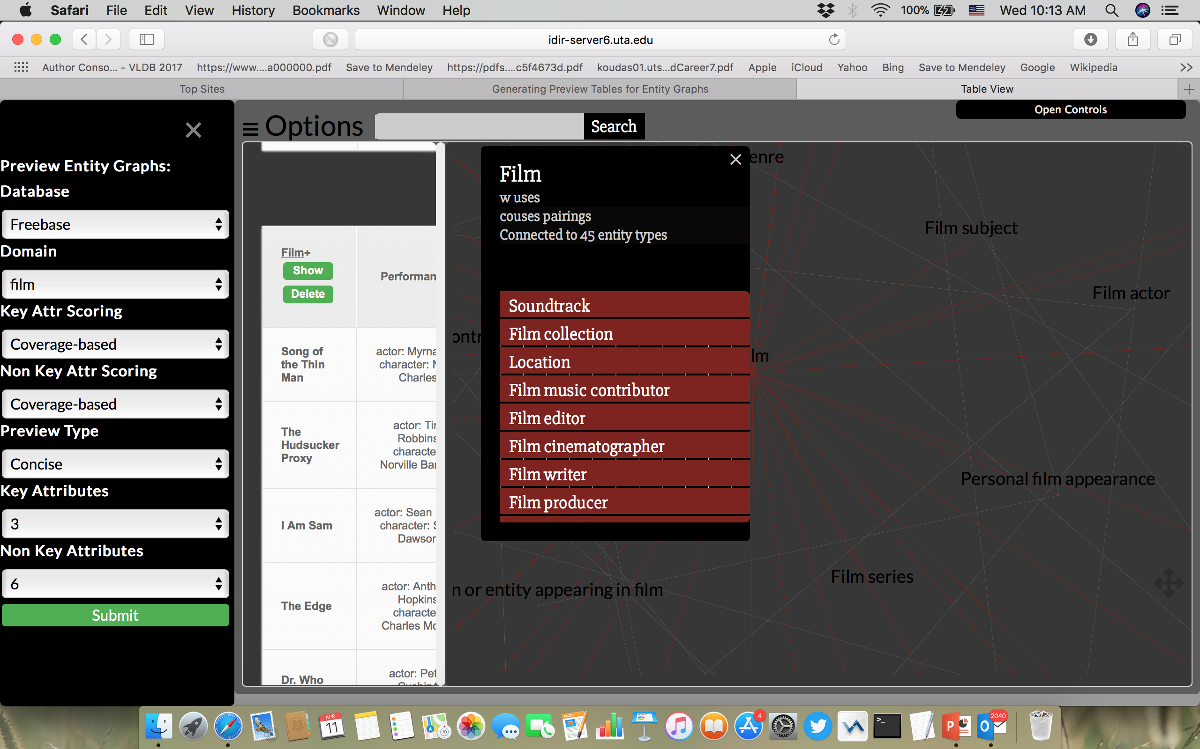




TableView: A Visual Interface for Generating Preview Tables of Entity Graphs
Sona Hasani*, Ning Yan^{1#} , Chengkai Li *
University of Texas at Arlington* Huawei U.S. R&D Center# Innovative Database and Information Systems Research (IDIR) Laboratory ¹The work was done while at UTA. Innovative Database and Information Systems Research (IDIR) Laboratory
34th IEEE International Conference on Data Engineering
April 16th-19th
Entity Graphs
Need for a Quick Overview
Preview Tables
Large and complex graphs capturing millions of entities and billions of relationships between entities.
Approach 1: Schema Graph
Approach 3: Preview Tables
Freebase : 1.9 billion triples
DBpedia : 3 billion triples
YAGO : 120 million triples
Linked Open Data : 52 billion triples
Steep Flag-Down Cost
Schema Graph itself can be too complex.
Applications: search, recommendation systems, business intelligence, health informatics, fact checking
Approach 2: Schema Summary
Schema summarization in relational database [Yang PVLDB09 , Yang PVLDB11]
XML summarization [Yu VLDB06]
Graph summarization [Tian SIGMOD08, Zhang ICDE10]
Too Many Previews. Which One to Choose?
Attribute Scoring
Optimal Preview Discovery
FILM | FILM SET DECORATOR | FILM EDITOR
FILM | FILM DIRECTOR | FILM PRODUCER
Key attribute scoring
Find the preview with highest score that satisfies
Size constraint
Number of key attributes K
Number of non-key attributes N
Distance between two preview tables d
Coverage-based method: Coverage(FILM) = 3 Random walk-based method : Stationary distribution of a random walk process defined over the schema graph
dist(Ti, Tj) ≤ d
PRODUCTION COMPANY | FILM
A
FILM WRITER | FILM
B
Concise
Tight
Diverse
Aggregate Scoring
Tight
dist(Ti, Tj) ≥ d
FILM | Performances | Genres | Directed By
Diverse
Score of the Preview
Non-key attribute scoring
FILM DIRECTOR | Films Directed
FILM FESTIVAL | Location | Focus
FILM | Actor | Genres
4 | 6 | 5
4 × (6+5) = 44
+
Coverage-based method : Coverage(Genres) = 5
Entropy-based method : Entropy(Genres) = (2/3) log(3/2)+(1/3) log(3/1) = 0.28
FILM PRODUCER | Films Produced
FILM COMPANY | Films
FILM ACTOR | Actor | Award Winners
2 | 6 | 2
60
FILM | Director | Genres
Men in Black | Barry Sonnenfeld | {Action Film, Science Fiction}
Men in Black II | Barry Sonnenfeld | {Action Film, Science Fiction}
I, Robot | _ | {Action Film}
FILM CHARACTER | Portrayed in Film
2 × (6+2) = 16
Concise preview: dynamic programming algorithm
Tight/Diverse preview: Apriori property algorithm
TableView Overview [Yan SIGMOD16, Hasani ICDE18demo]
A concise preview generated for FILM domain with 3 key attributes and 6 non-key attributes.
Domains: film, book, music, TV, people
Key attribute scoring: Coverage-base, Random Walk-based
Non-key attribute scoring: Coverage-based, Entropy-based
Preview type: Concise, Diverse, Tight
Configuration Panel
Preview Panel
Schema Graph
Interacting with the Preview Tables
Manual Preview Tables
Drop any column from the preview tables and refresh the preview.
Expand and collapse the sample data section of the preview tables.
Additional information for each column of the preview tables.
Export the preview into PDF.
Find the entity type in the schema graph that corresponds to the key attribute of a preview table.
References
https://idir.uta.edu/tableview
[Yan SIGMOD16] N. Yan, S. Hasani, A. Asudeh, and C. Li, “Generating preview tables for entity graphs,” in SIGMOD, 2016, pp. 1797–1811. (best reproducibility award from SIGMOD2017 )
[Hasani ICDE18demo] S. Hasani, N. Yan, and C. Li, “ TableView: A Visual Interface for Generating Preview Tables of Entity Graphs,” in ICDE, 2018.
[Yang PVLDB09] X. Yang, C. M. Procopiuc, and D. Srivastava, “Summarizing relational databases,” PVLDB, vol. 2, no. 1, pp. 634–645, 2009. [Yang PVLDB11] X. Yang, C. M. Procopiuc, and D. Srivastava, “Summary graphs for relational database schemas,” PVLDB, vol. 4, no. 11, pp. 899–910, 2011.
[Yu VLDB06] C. Yu and H. V. Jagadish, “Schema summarization,” in VLDB, 2006, pp. 319–330.
[Tian SIGMOD08] Y. Tian, R. A. Hankins, and J. M. Patel, “Efficient aggregation for graph summarization,” in SIGMOD, 2008, pp. 567–580.
[Zhang ICDE10] N. Zhang, Y. Tian, and J. M. Patel, “Discovery-driven graph summarization,” in ICDE, 2010, pp. 880–891.

